Slide 1
DATA 230 Data Visualization Week 1
Department of Applied Data Science San Jose State University Instructor: Robert Nicholson
sjsu.edu/people/robert.nicholson

Slide 2
Basic Info
Office hours
Fri 2:00-4:00 pm (or by appointment) via Zoom
Website
Syllabus, slides, assignments, etc, will be posted in Canvas
Faculty webpage: https://www.sjsu.edu/people/robert.nicholson/
Syllabus

Slide 3
Your Individual Overall Class Grade
50% assignments
20% midterm
30% final
During the semester, keep track of your progress in Canvas.
At the end of the semester, students with the median score will get the B+ grade.
Higher and lower grades will then be assigned based on how the scores cluster above and below the median. Approximately one third of the class will earn higher grades, and another one third will earn lower grades.
Therefore, your final class grade will be based primarily on your performance relative to the other students in the class.

Slide 4
Course Learning Outcomes
CLO 1: Understand the conceptual, design, and cognitive basis for effective data visualizations.
CLO 2: Identify and correct interface design and user interaction issues in data visualization.
CLO 3: Be able to effectively use a range of current data analysis and presentation tools in support of objectives (2) and (3).
This is an introductory/survey course. We’ll cover a lot of different topics – briefly. Depending on your background, some of the topics may be very easy for you, and some may be difficult.

Slide 5
Why Data Visualization?
Understanding
Understanding and exploring the data
Humans are incredibly good at recognizing visual patterns
Often a good first step before starting analysis

Slide 6
Why Data Visualization?
Presenting
Presenting and explaining conclusions is a big part of the data analyst’s job
Visualization is an effective tool for communicating

Slide 7
Why Data Visualization?
Persuading
Sometimes a data scientist’s role is persuading, or helping to persuade
Humans react differently to visual information; it can have much greater psychological impact

Slide 8
Why Data Visualization?
Interacting
Interactive visualization tools can support “discovery” and “what-if” explorations
Interaction can be a more effective way to absorb information
Interactive tools can support decision making

Slide 9
In This Class
Good and Bad visualization
Types of data visualization
Preparing data for visualization
Visual storytelling
Psychological principles
Accessibility
Dashboards & interaction
UI Design

Slide 10
In This Class (continued)
Visualization tools
Microsoft Excel
Python libraries
Tableau
Splunk
Power BI (PIBX)
Standards
File Formats

Slide 11
Good Data Visualization:
Communicates useful insights
Is easy to understand
Is easy to read
Is accessible
Is aesthetically pleasing
Is easy to interact with and use (good use interface)
Is unbiased (or appropriately biased)

Slide 12
Chart Types
Good Visualization Starts with the Right Representation

Slide 13
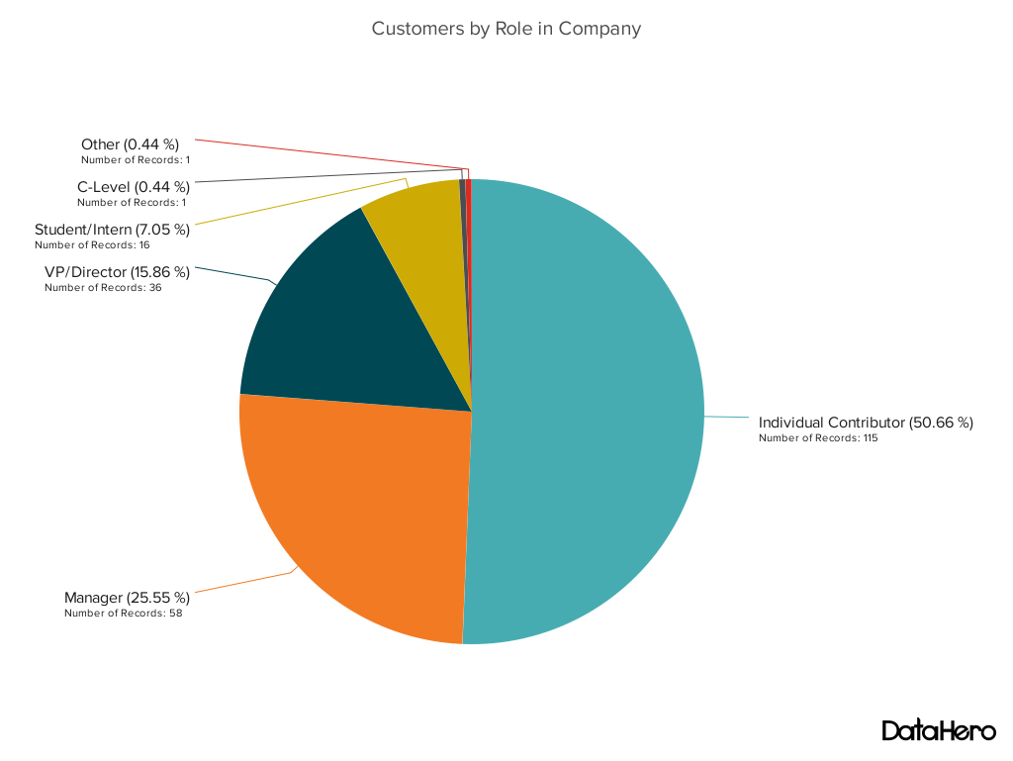
Pie Chart
Proportions – parts of a whole

Slide 14
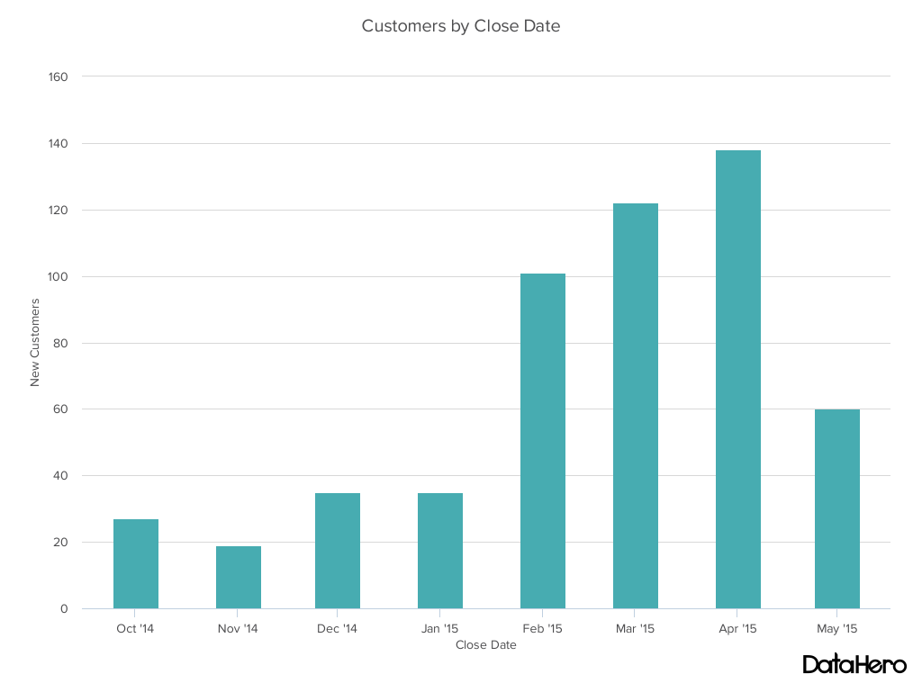
Bar Chart – Horizontal or Vertical
A set of discrete data points

Slide 15
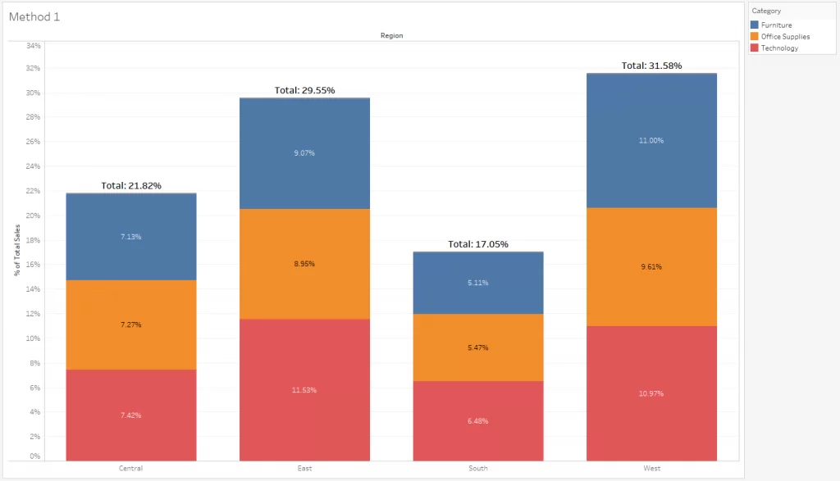
Stacked Bar Chart
Contributions to each value

Slide 16
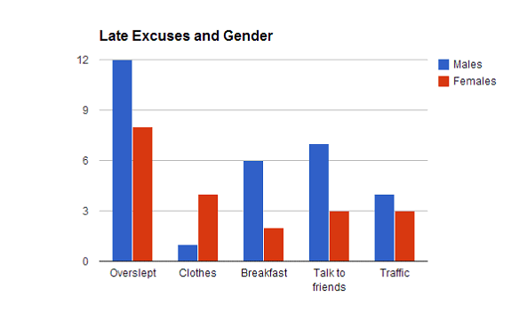
Side-by-Side (Multiset) Bar Chart
Comparing values in each category

Slide 17
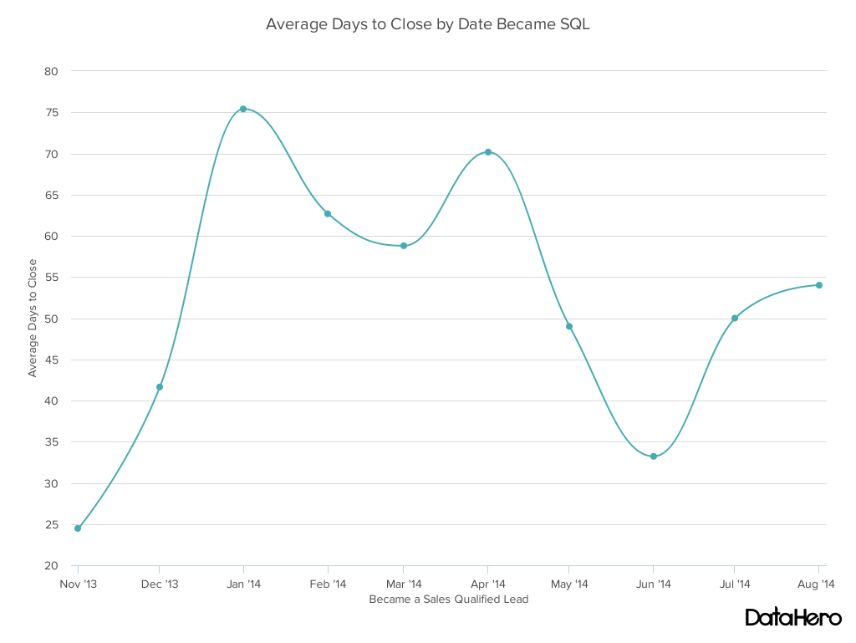
Line Chart
Trends – continuous data

Slide 18
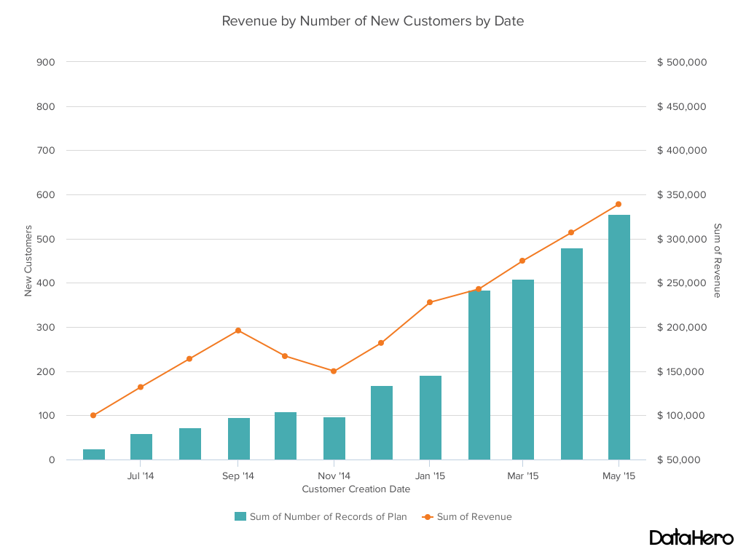
Dual Axis Chart
Related data items

Slide 19
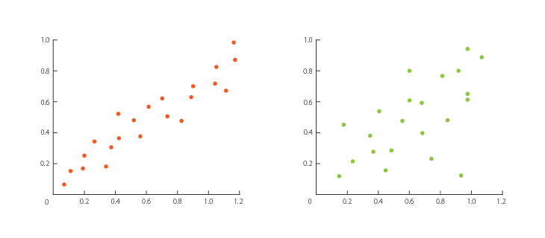
Scatterplot
Seeing trends in discrete data points

Slide 20
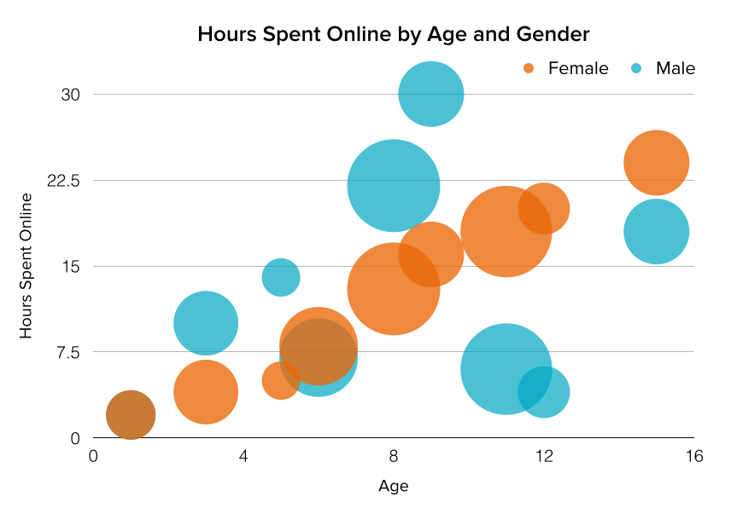
Bubble Chart
Adds a dimension to a scatterplot

Slide 21
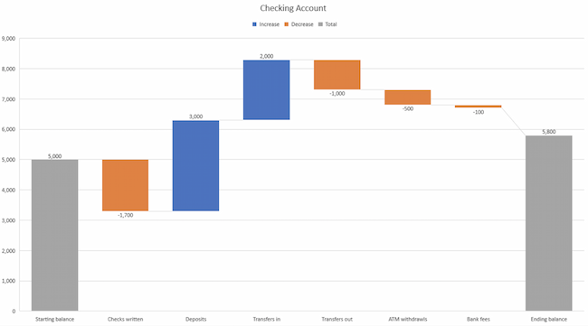
Waterfall
Shows a running total with additions and subtractions

Slide 22
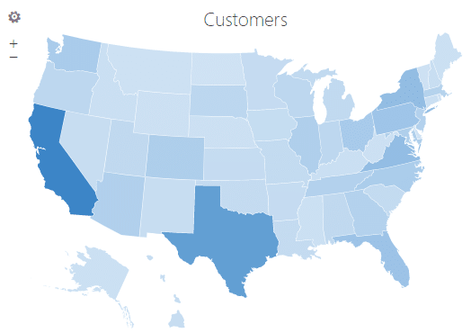
Geographic Heat Map
Data relating to geographic regions

Slide 23
Many More Chart Types
The Data Visualization Catalogue
https://datavizcatalogue.com/
Search the Catalogue by Function
https://datavizcatalogue.com/search.html

Slide 24
Bad Visualizations
Pitfalls to Avoid

Slide 25
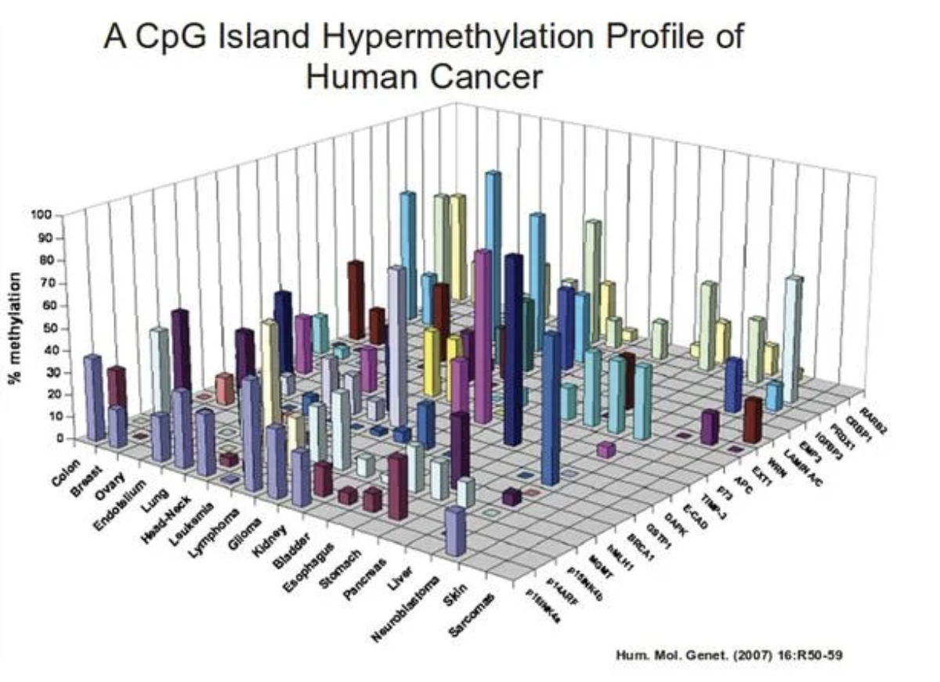
A Few Bad Visualizations

Slide 26
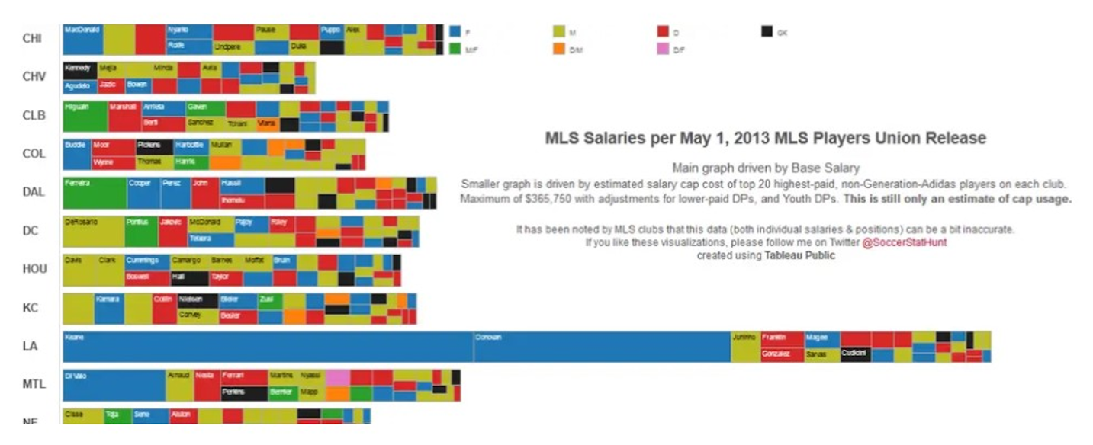
A Few Bad Visualizations

Slide 27
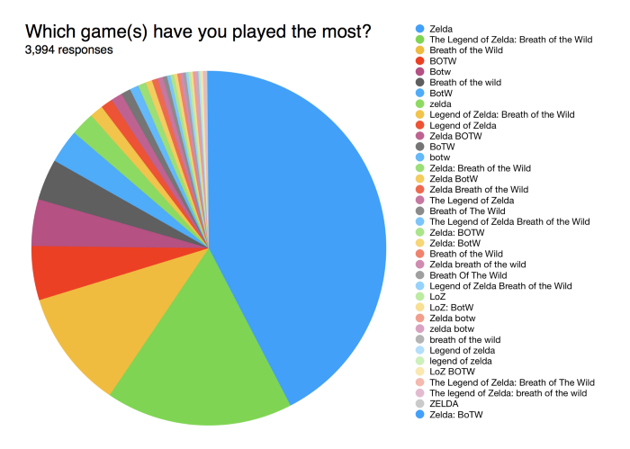
A Few Bad Visualizations

Slide 28
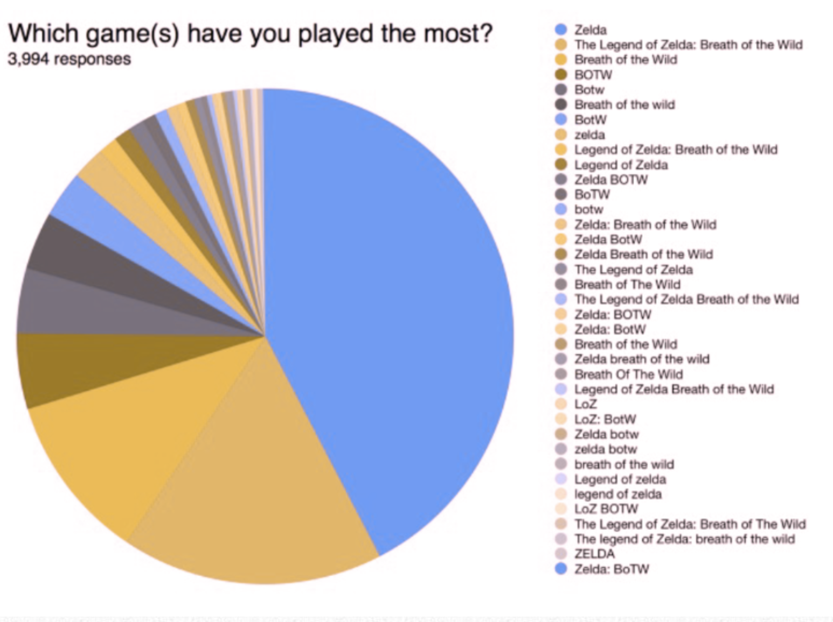
A Few Bad Visualizations
Green-Blind/Deuteranopia

Slide 29
Use of Color
Because a significant number of people have impair color vision, colors should not in general be used as the sole distinguishing characteristic. Use different shades, patterns, or shapes.
To help you make good color choices, there are online tools that will allow you to simulate color vision impairment:
https://www.color-blindness.com/coblis-color-blindness-simulator/
https://pilestone.com/pages/color-blindness-simulator-1

Slide 30
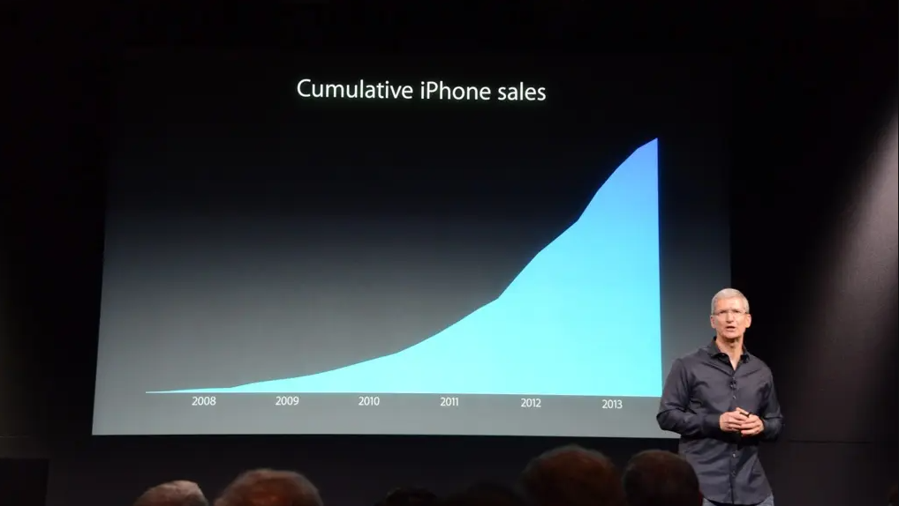
A Few Bad Visualizations

Slide 31
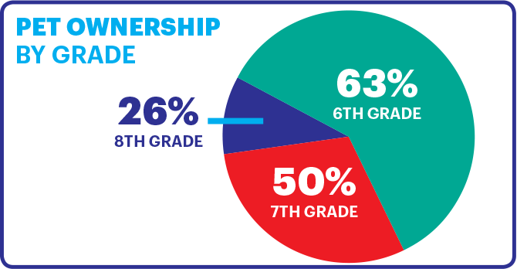
A Few Bad Visualizations

Slide 32
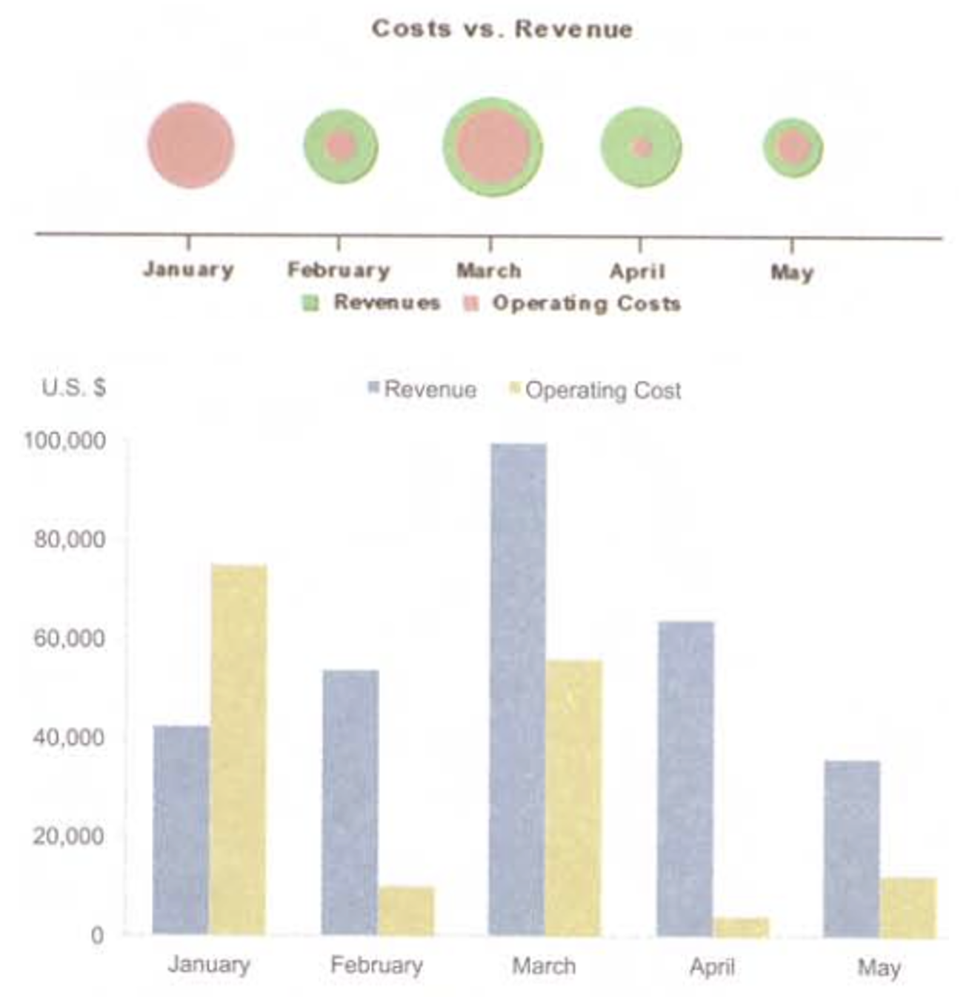
A Few Bad Visualizations

Slide 33
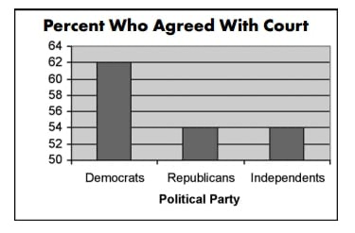
A Few Bad Visualizations

Slide 34
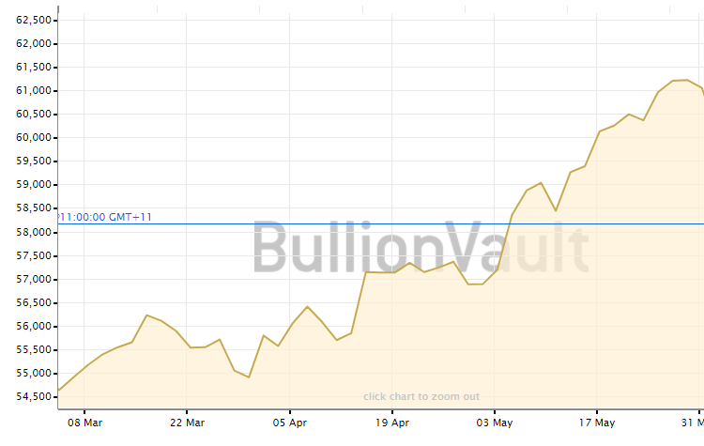
A Few Bad Visualizations

Slide 35
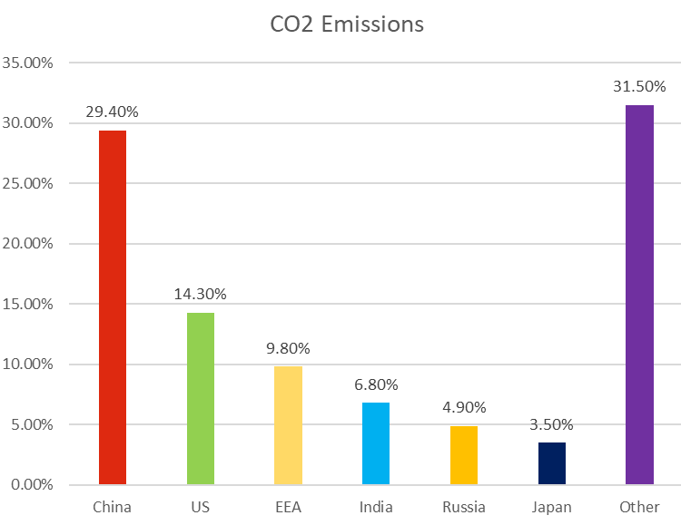
A Few Bad Visualizations

Slide 36
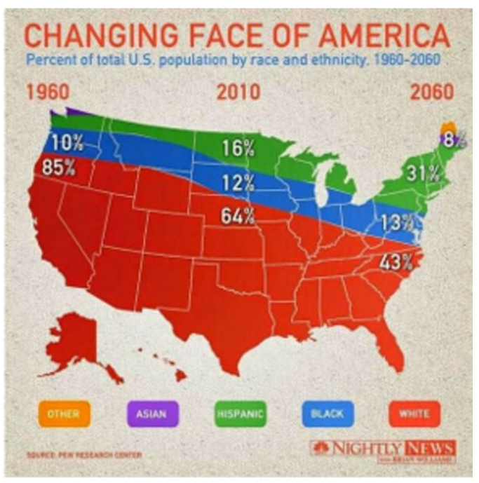
A Few Bad Visualizations

Slide 37
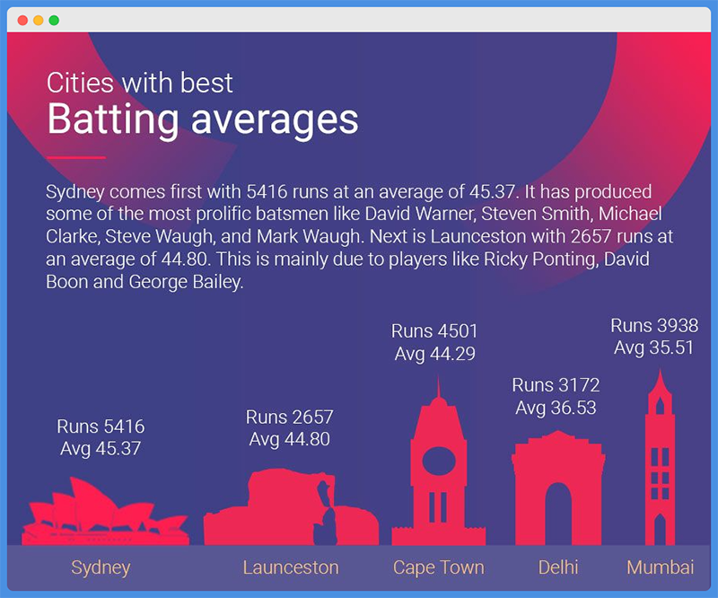
A Few Bad Visualizations

Slide 38
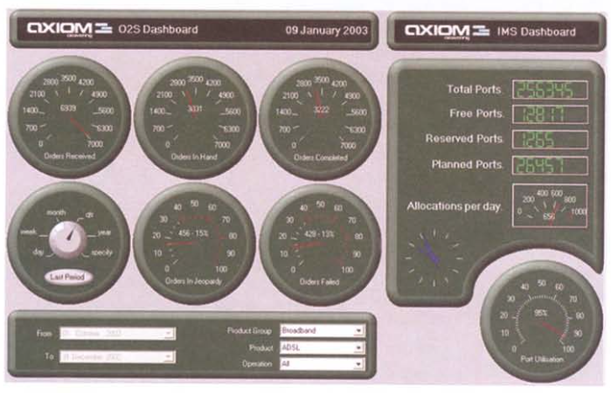
A Few Bad Visualizations
Information Dashboard Design, 2nd ed.
by Stephen Few
Analytics Press, 2013

Slide 39
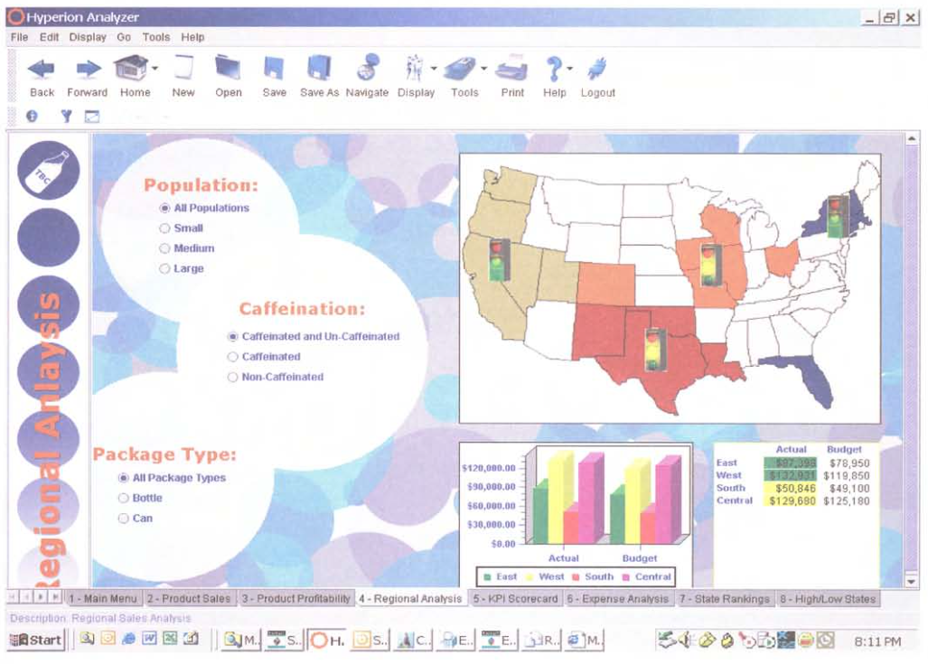
A Few Bad Visualizations
Information Dashboard Design, 2nd ed.
by Stephen Few
Analytics Press, 2013

Slide 40
Bad Design – Common Problems
Poor choice of chart type
Information overload
Misleading scale
Missing axis labels or scales
Incorrect data
Burying (not highlighting) key information

Slide 41
Bad Design (continued)
Inaccessible
Type too small
Poor color choices
Use of audio cues or messages
Meaningless (distracting) decoration & visual effects
Unclear (what does the graphic represent)
Poor aesthetics (ugly!)

Slide 42
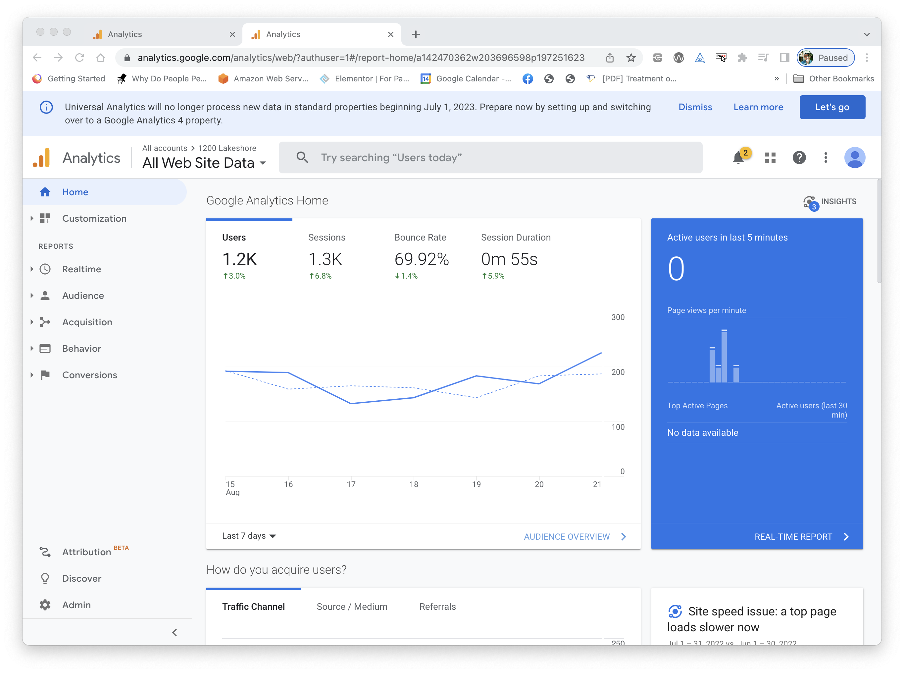
A Well- Designed Control Panel?

Slide 43
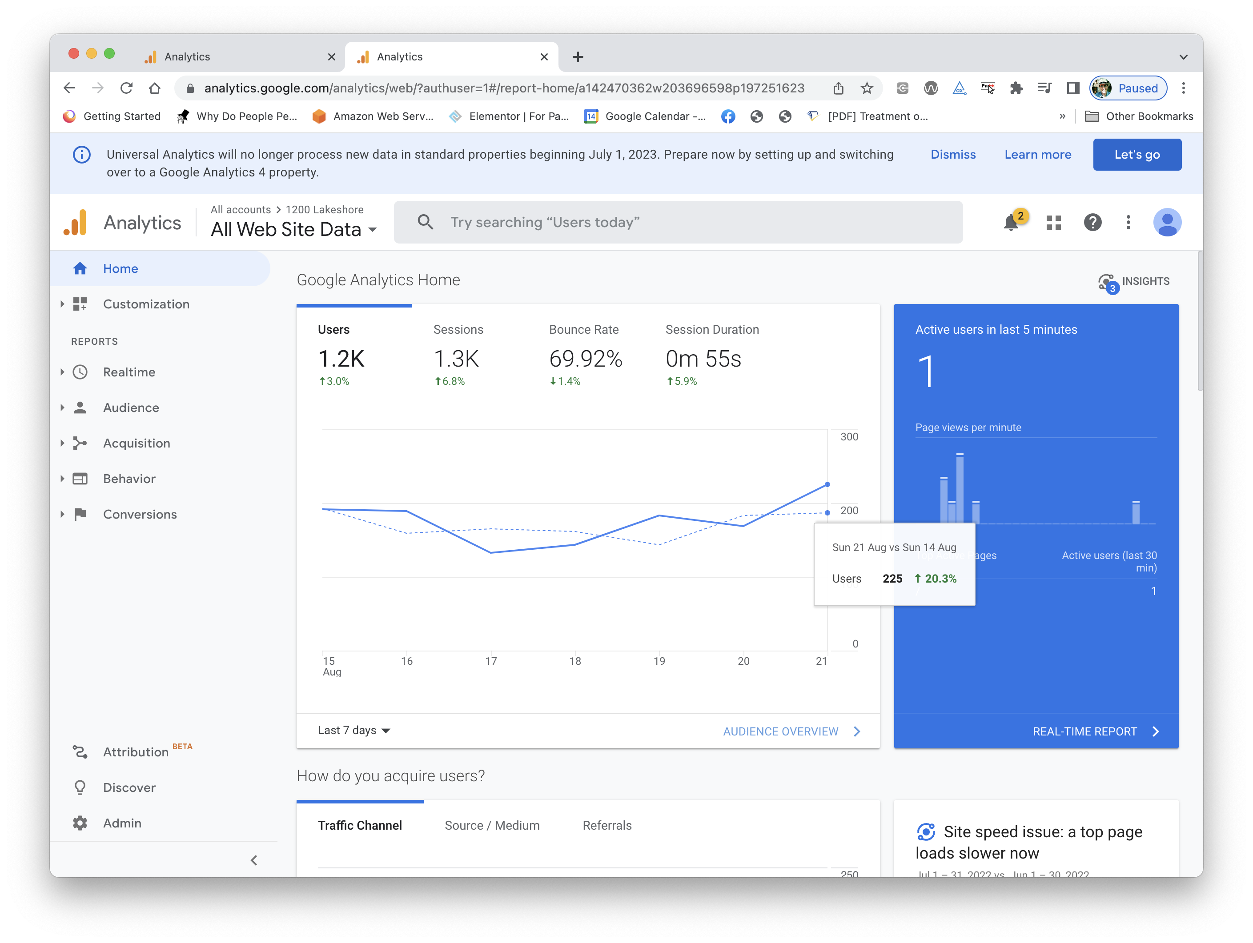
A Well- Designed Control Panel?

Slide 44
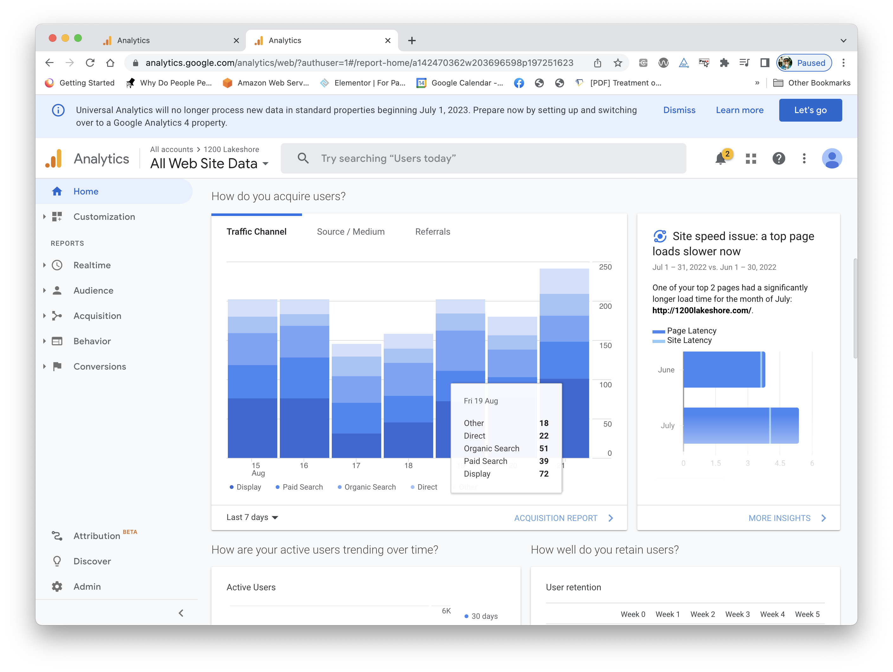
A Well- Designed Control Panel?

Slide 45
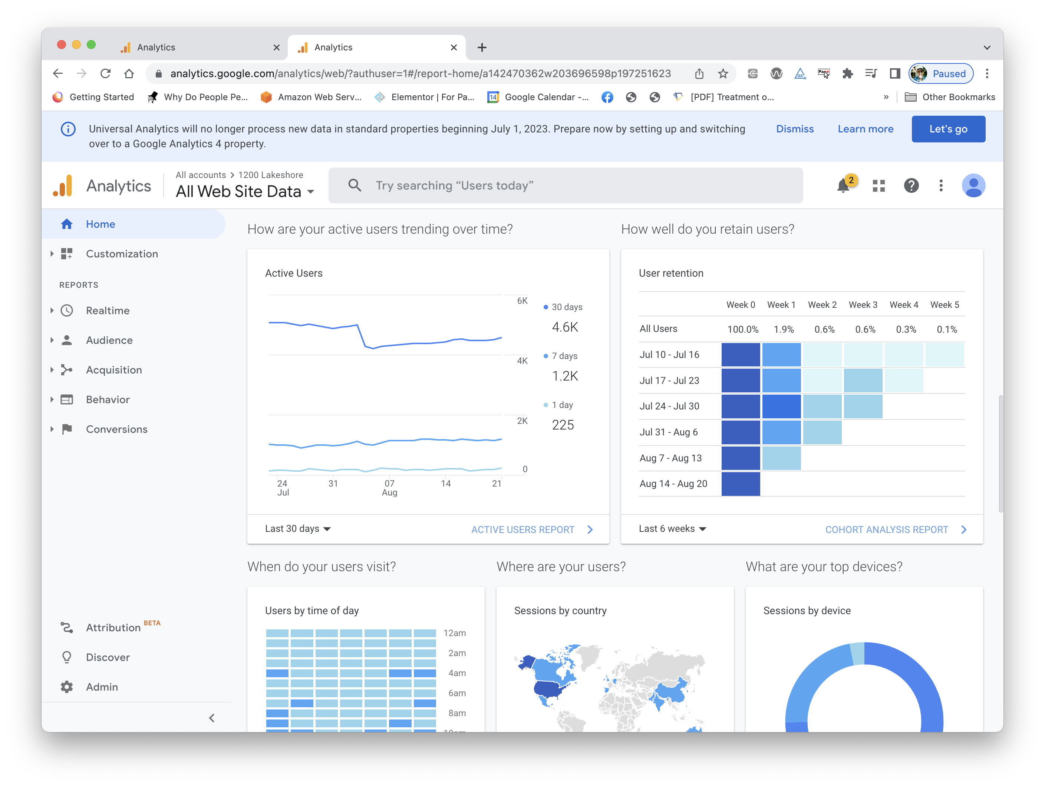
A Well- Designed Control Panel?

Slide 46
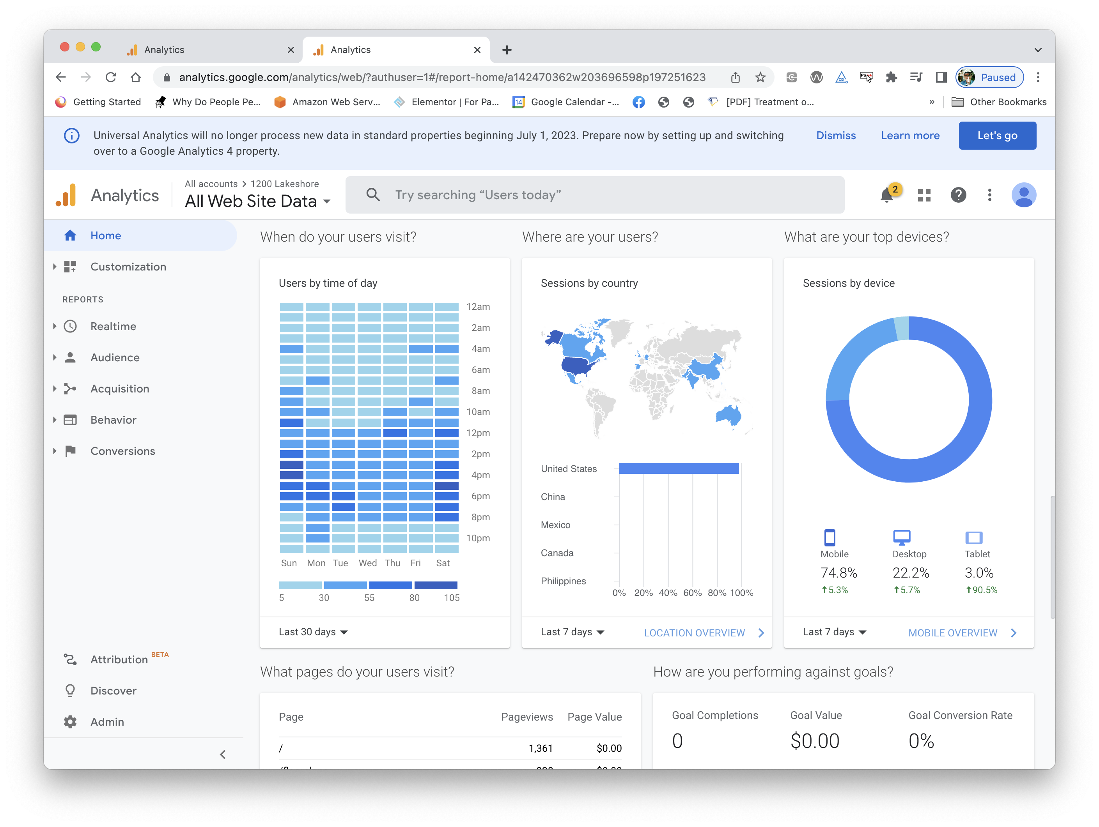
A Well- Designed Control Panel?

Slide 47
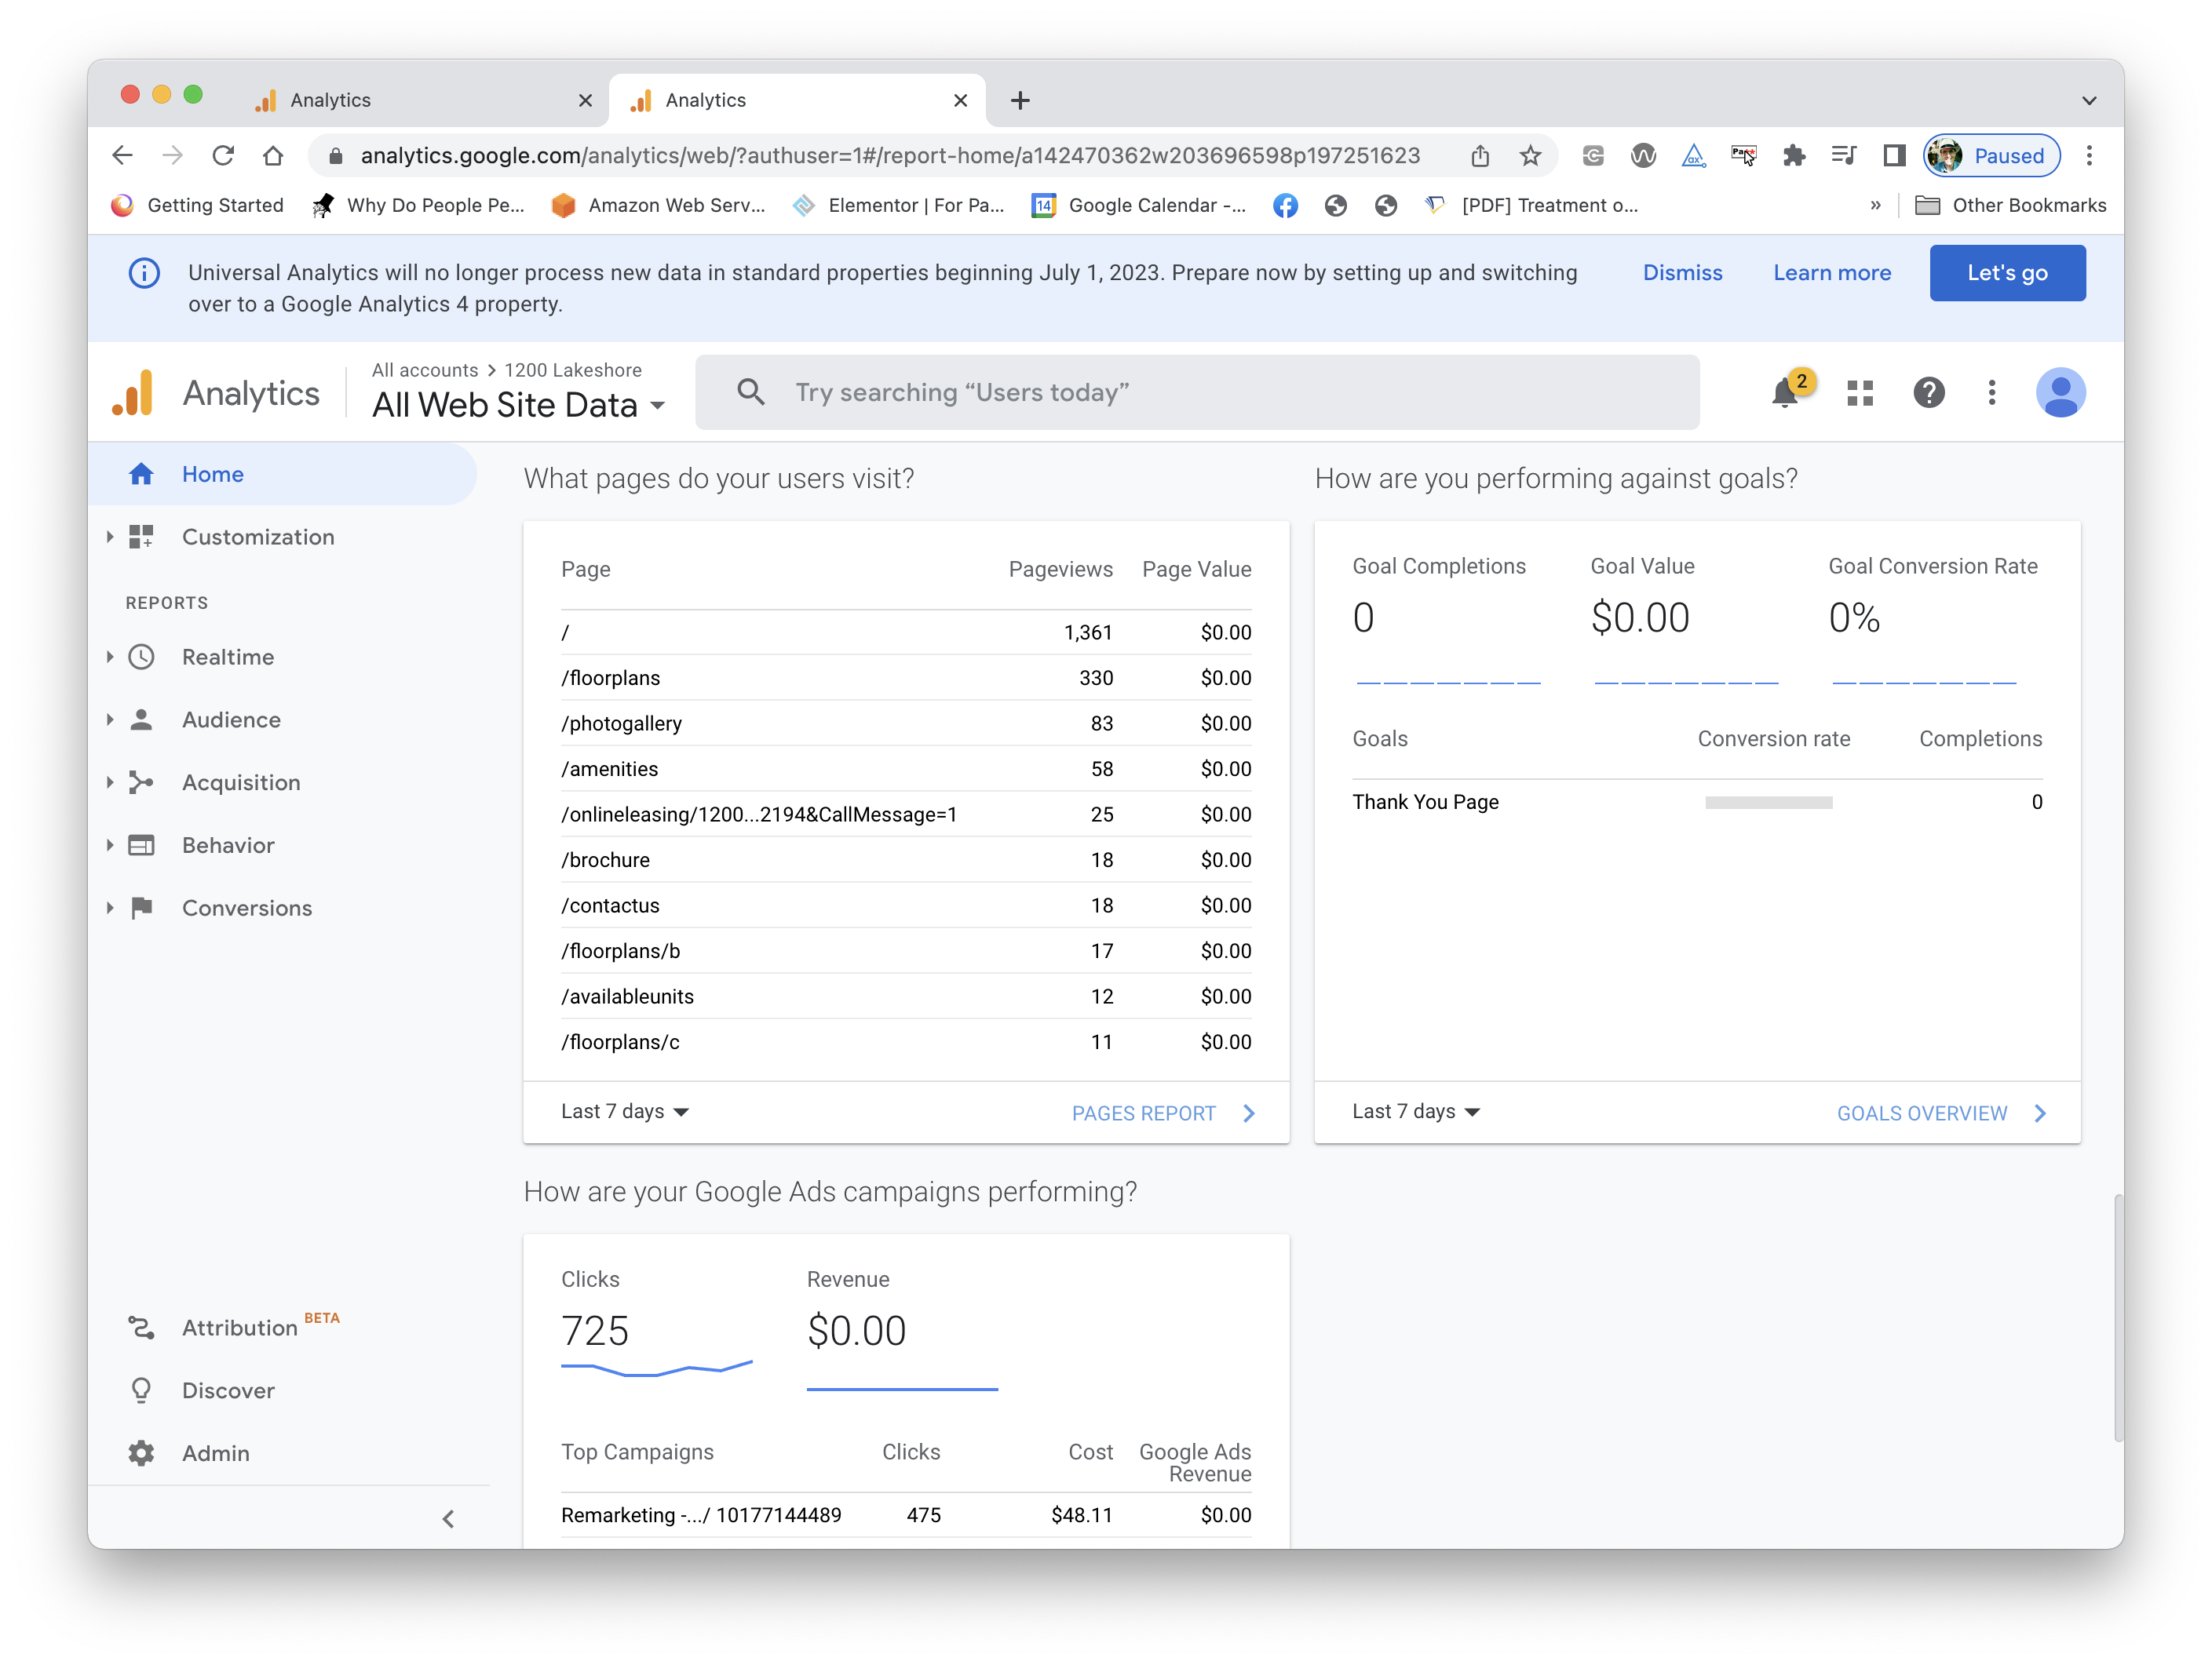
A Well- Designed Control Panel?

Slide 48
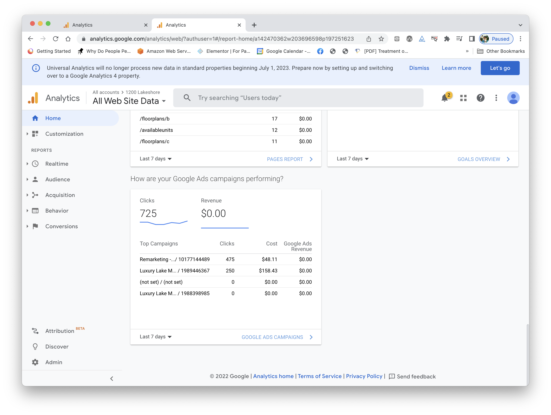
A Well- Designed Control Panel?

Slide 49
Assignment 1 – Due Next Week
You’ll submit a document in PDF form for this assignment.
On the web, find examples of five different data visualization problems. (Exactly five – no more, no less.)
Paste a screenshot of each into your document.
Based on the flaws discussed in class, identify the type of visualization problem that each illustrates.
Describe what you would do differently to fix the problem. You are welcome to create a graphic that shows how you would fix the problem, but that’s not necessary – a text description is fine.
Submit to Canvas as “Lastname-Assignment-1.pdf”

Slide 50
Assignment 1 – “permission to cheat”
You’ll find a lot of websites with examples of bad visualizations. You are welcome to use those for your assignment. (That’s where most of my examples came from – don’t use the same images!)
Just be sure to identify the problem based in the things I’ve just discussed, and explain how you would fix it.
Of course, it might be fun to actually look at some business and science sites to see if you can find some bad examples on your own.

